Slide 1
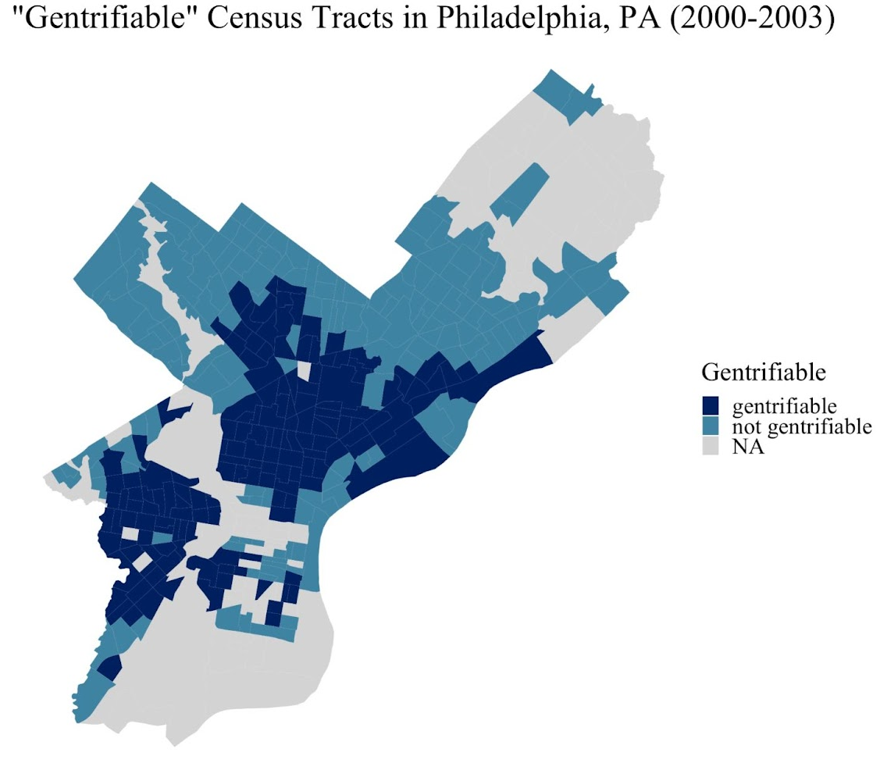
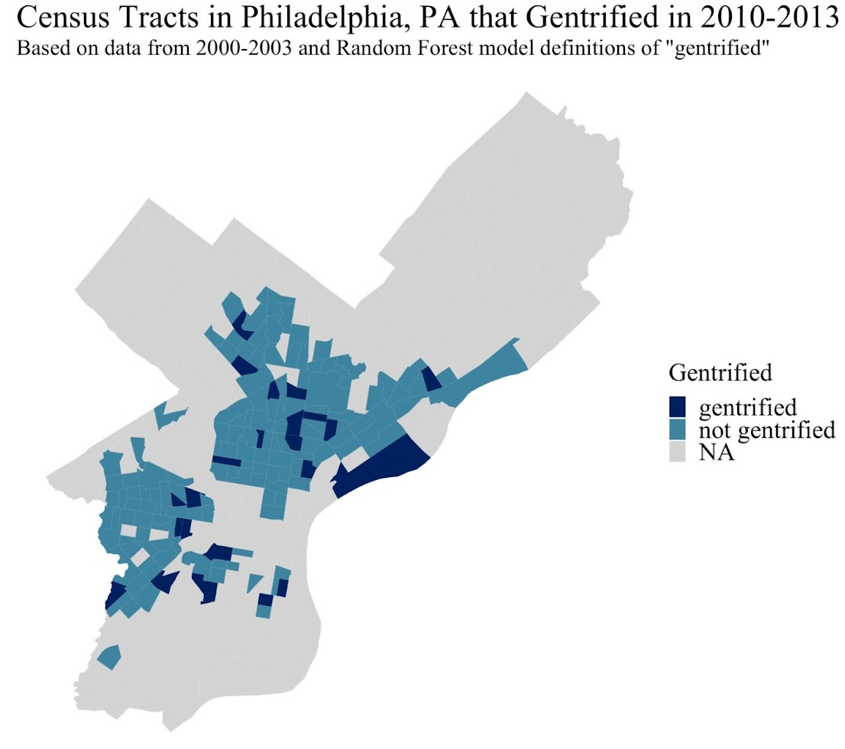
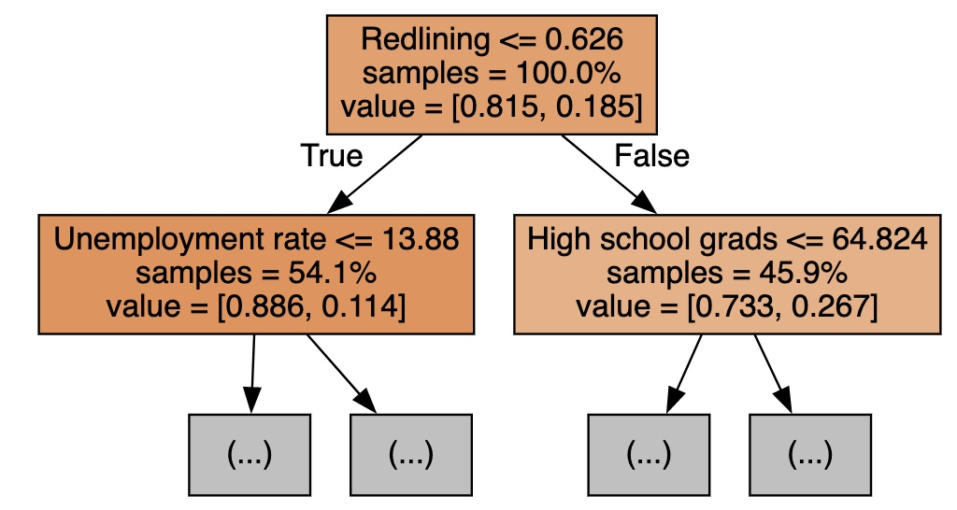
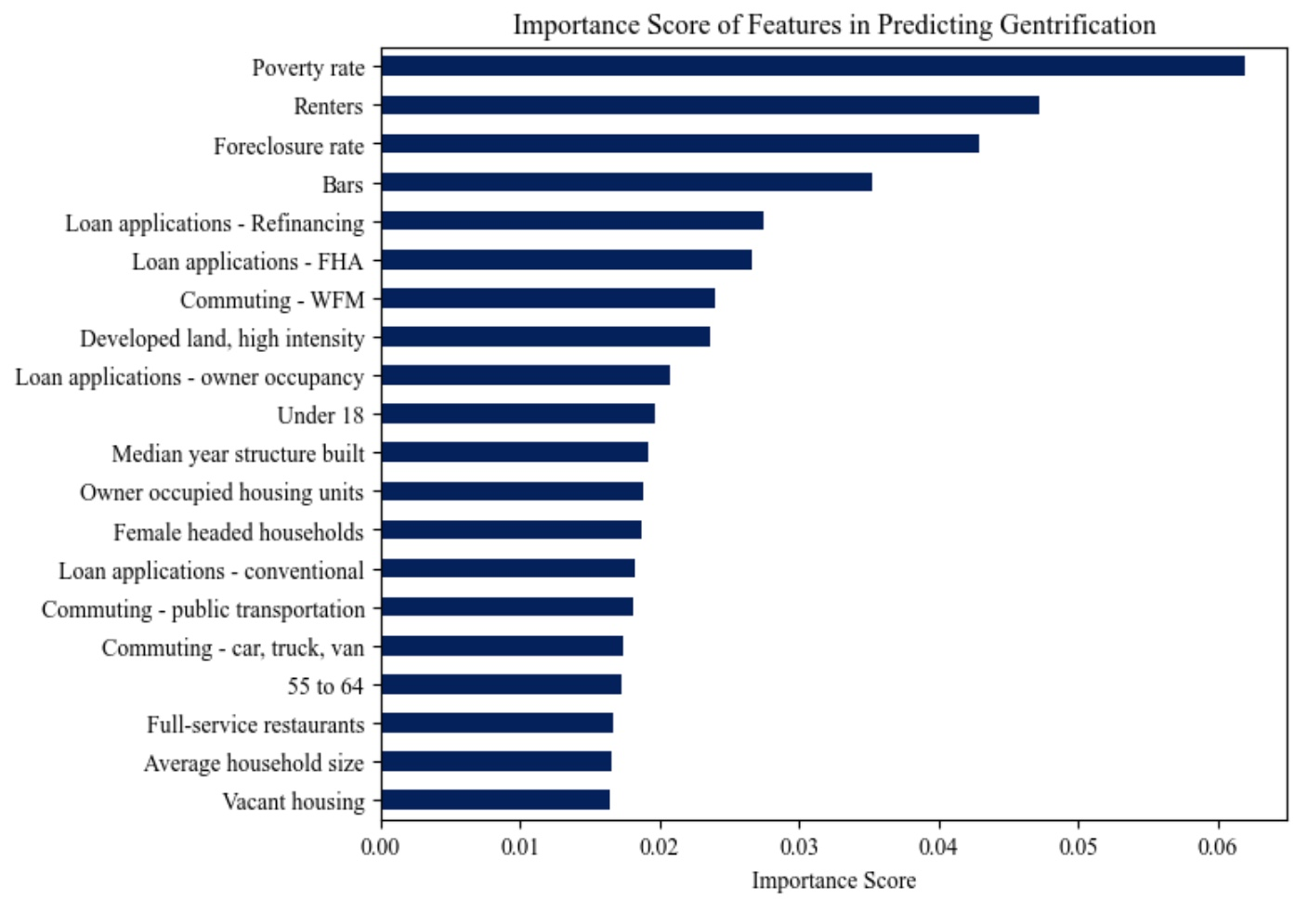
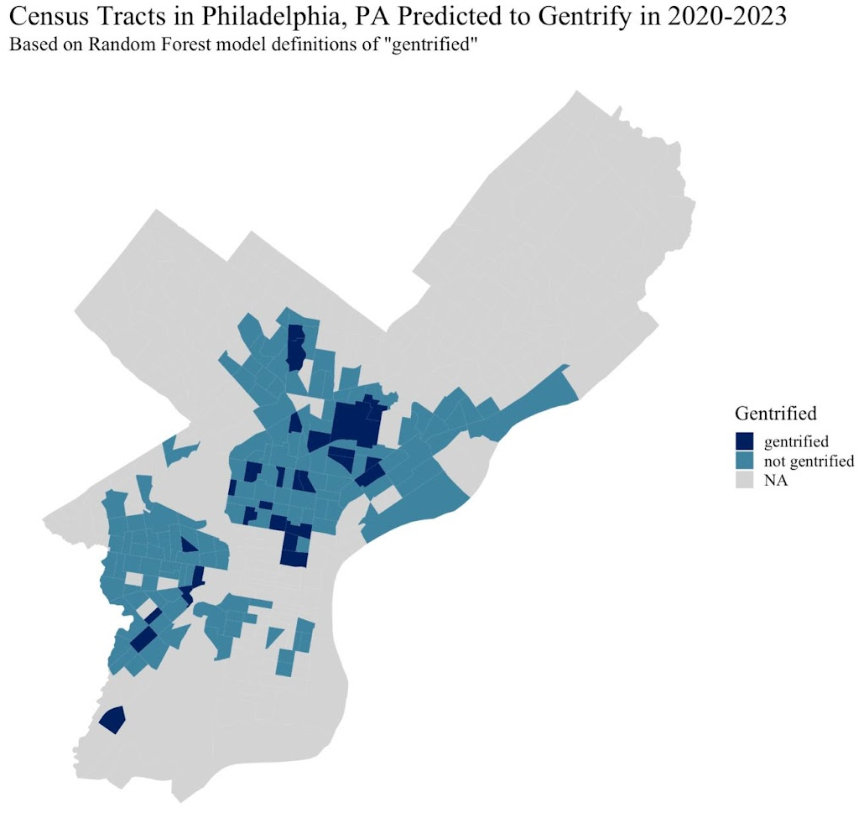
Predicting U.S. Urban Gentrification with Machine Learning QSS Major One Quarter Project (23W), Claire Meli
Defining Gentrification
Gentrification: displacement of low SES groups by influx of high SES groups
Research wants to find causes and effects of gentrification to help low SES people facing this issue
Gentrification is abstract: how do we even define it?
Important problem: drastically affects which areas are considered as gentrified
Gentrification in Quantitative Research
Strengths of quantitative research: trends found are more generalizable, look at less studied/smaller areas
Here, defined based on relative changes in SES and housing affordability (Owens 2012, Reades et al. 2019)
Machine Learning and Gentrification
STRENGTHS: considers many vars at once despite collinearity and pulls out the most important features
PRESENT STUDY: random forest (supervised binary classification) ML model
BUILDS ON: Study across the whole U.S.; New/more thorough features considered
Methods
Introduction
Results: Accuracy, Predictions
“Gentrifiable” tracts: tract-level median income less than the city-level median income
“Gentrified”: changes in tract >3rd quartile of city-level changes between 10-year periods regarding:
(1) household income, (2) residents with BA, (3)
professional workers, (4) rent, (5) home value
Create gentrification index of above vars using PCA
Principal component accounts for ~70% of variance
Random Forest — Feature Selection and Importance
Randomly subsets data, continues to chose which variables (1 by 1) best divide data until distinct classification is achieved
Importance: how
well node splits data
between classifications,
probability of a case
reaching that node
Training data: 90% of 2,284 gentrifiable tracts (2000-2003)
Testing data: 10% of 2,284 gentrifiable tracts(2000-2003)
Accuracy: ~78%
False negative rate: ~80%
missed many “gentrified” classifications
Indicates that there may be several factors still missing as predictor variables
Data
Results: Feature Importance
Conclusion
Considered 4,599 urban census tracts and 79 predictor variables, including…
Demographics (race, ethnicity, age)
Amenities (arts & entertainment, restaurants & bars, personal care services, retail, banks, etc.)
Health Environment (land area cover, pollutants, healthcare resources, etc.)
Social Environment (law enforcement)
Households (family vs. nonfamily, household size)
Housing (housing units, year built, vacancy, house value, gross rent, etc.)
Transportation (means of commuting, avg. commute)
Improvement on Reades
Amenities
Rent in 2000 period
Mortgage/loan rates
Important to understand the process of gentrification in order to better serve disadvantaged and vulnerable communities
Predictors related to neighborhood disadvantage had highest importance, these communities are most at risk
Although the model had high accuracy, the high false negative rate means there are more underlying factors in the gentrification process
New measure not yet in literature: REDLINING
proportion of tract area that received a “D” HOLC rating
Most importance features: Neighborhood Disadvantage, Food Amenities and Structural Attractions, Work Accessibility, High SES Home Ownership
Less important features: Personal care/entertainment amenities, social services, occupations
Still proves the power of predictive modeling in understanding the causes and hopefully solutions to gentrification

